Slide 1
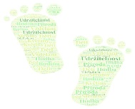
KA1 „Profesní rozvoj 21″ project “ Professional development 2021″
K1-2020-1-CZ01-KA101-077434
Zpracoval: Mgr. Petr Holánek, Mgr. David Filipi, Mgr. Radka Těšíková
Autoři fotografií: Mgr. David Filipi, Mgr. Radka Těšíková
Překlad: Mgr. Jan Melichárek

Slide 2
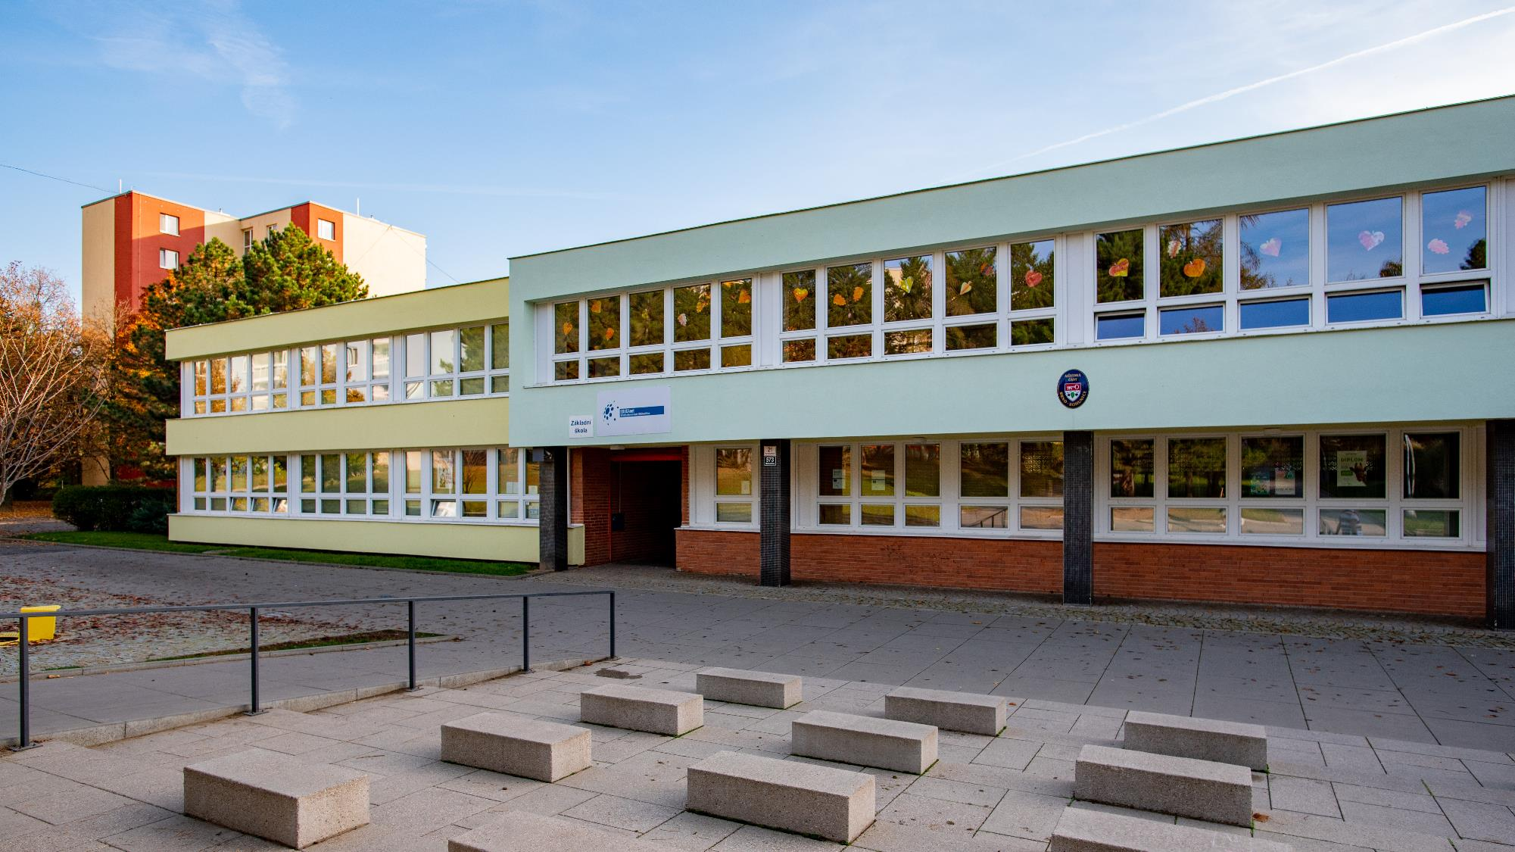
Elementary School Brno, Arménská 21, introduces itself

Slide 3
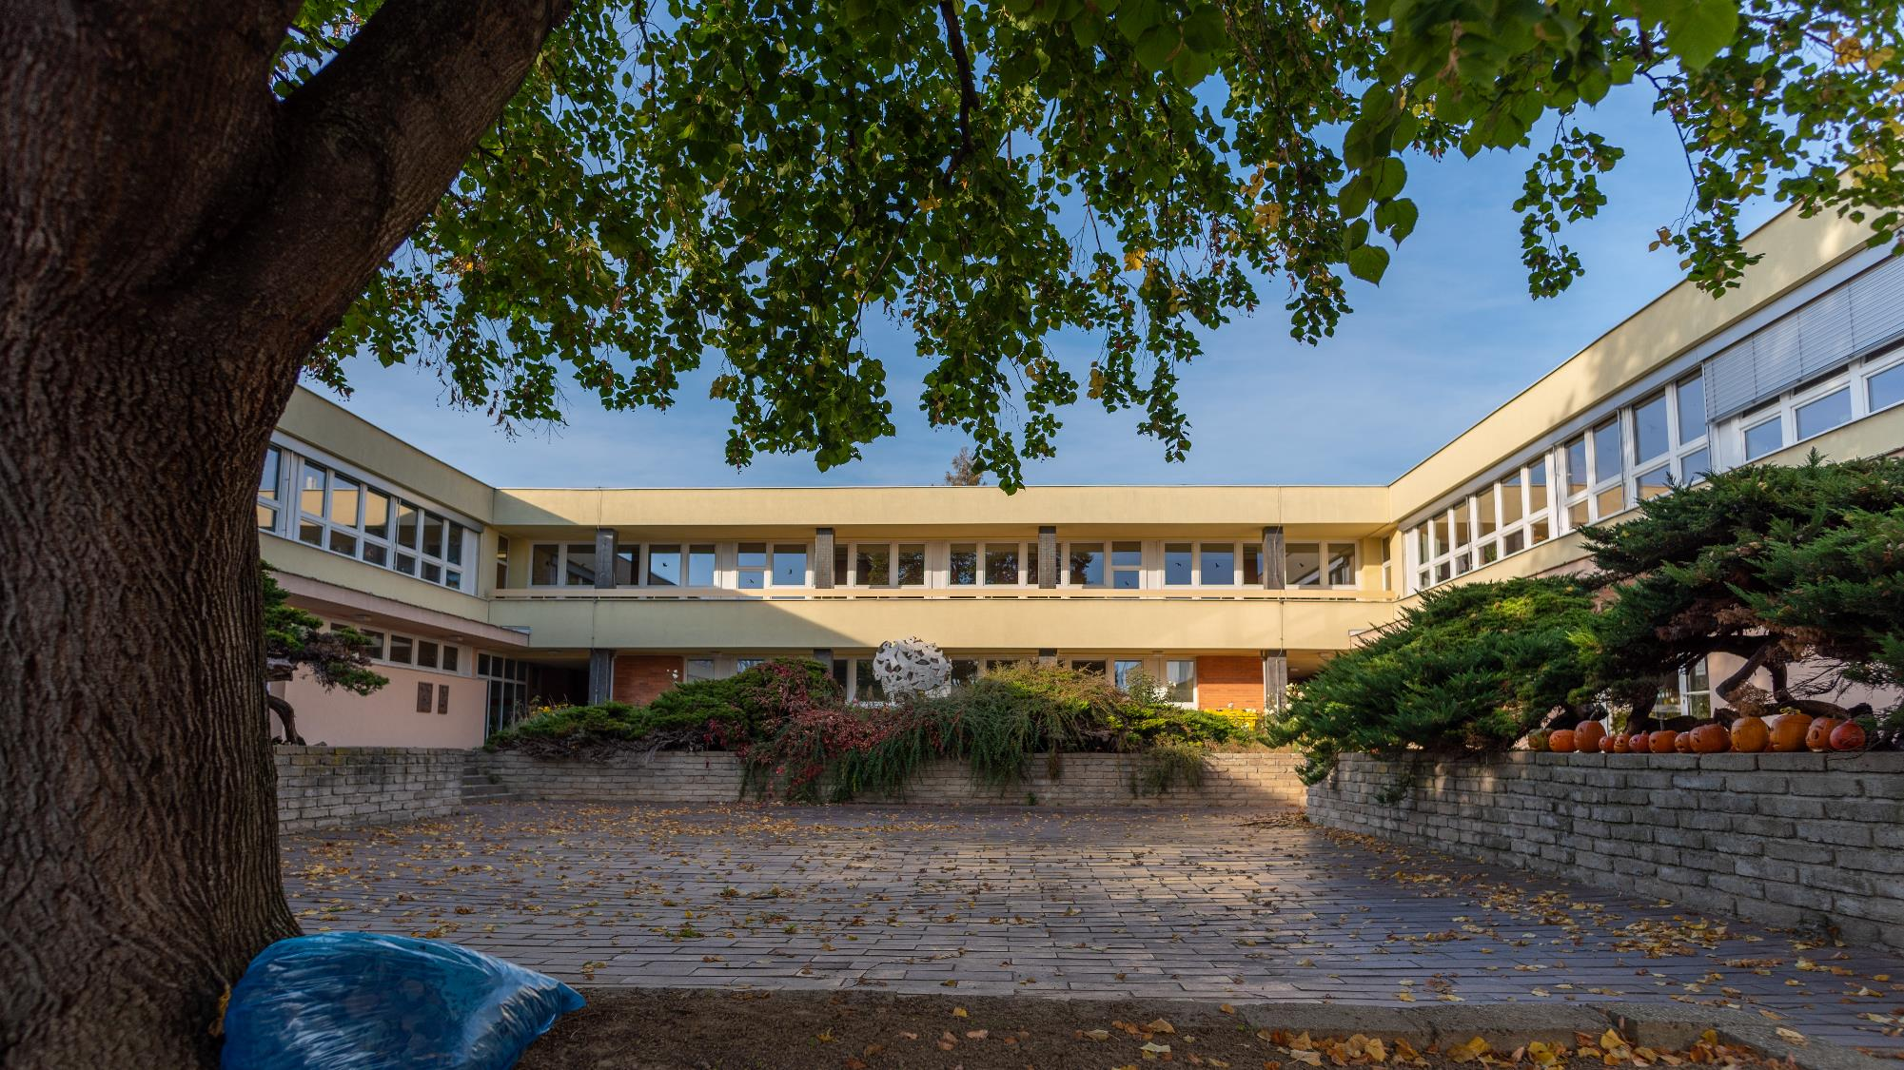
Elementary School Brno, Arménská 21
The goal of our school is to offer a good quality education to our pupils in safe environment which does not exclude openedness to all at the same time.

Slide 4
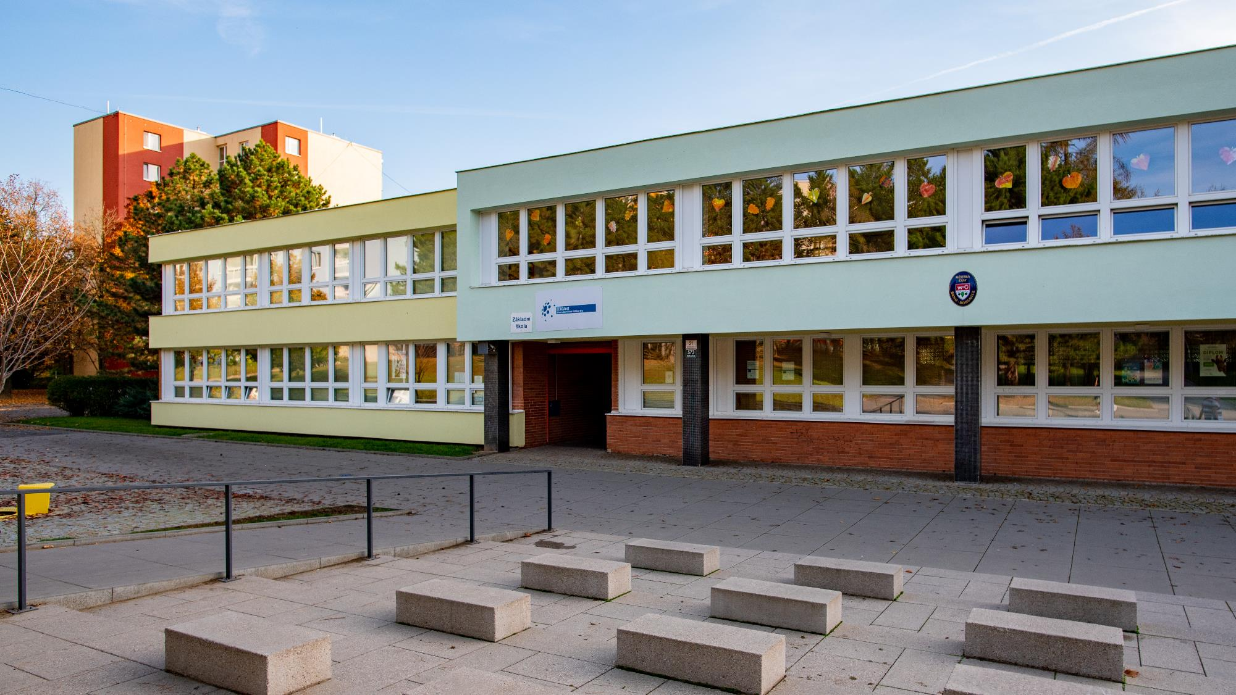
There are three pillars in our school educational process:
A quality school – it knows where to focus and follows it succesfully (inspired by recommendations of Czech School Inspectorate )
A safe school – a child is safe here and feels safe (a cooperation with Safe School Association)
An open school – is healthy and motivating (we are a member of Brno‘s Open School Network)

Slide 6
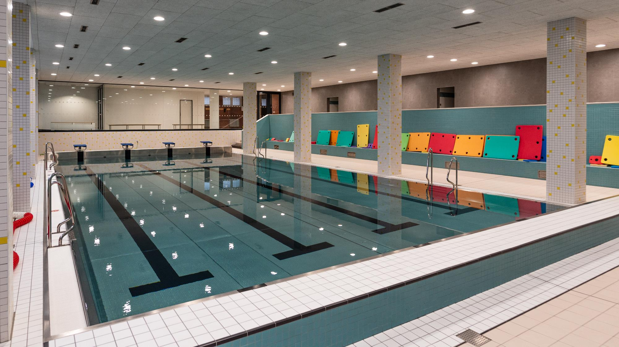
Our primary school is a faculty school of Faculty of Education at Masaryk University. It focuses on sport, especially on swimming in cooperation with Kometa Brno Club.
Our pupils get excellent results in nationwide sport competitions every year thanks to our good quality sports background (renewed swimming pool, school playground with athletic circle and a big school gym.

Slide 8
A SCHOOL LOGO
Old:
New:

Slide 9
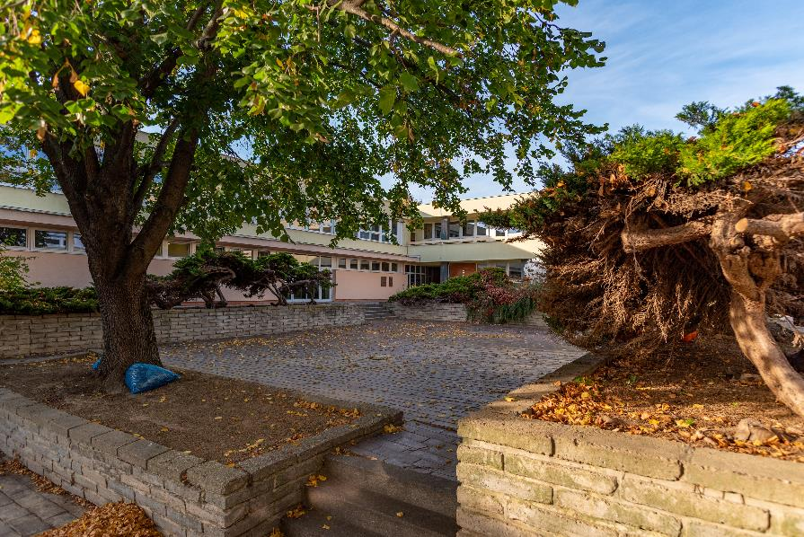
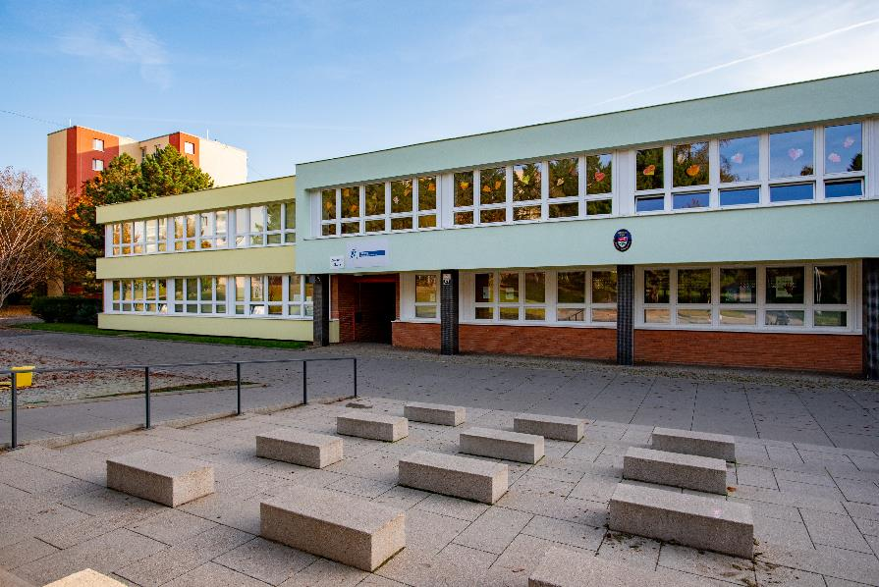
A school building

Slide 10
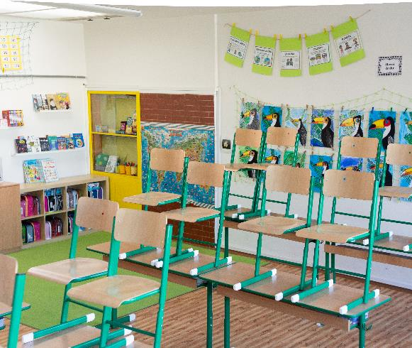
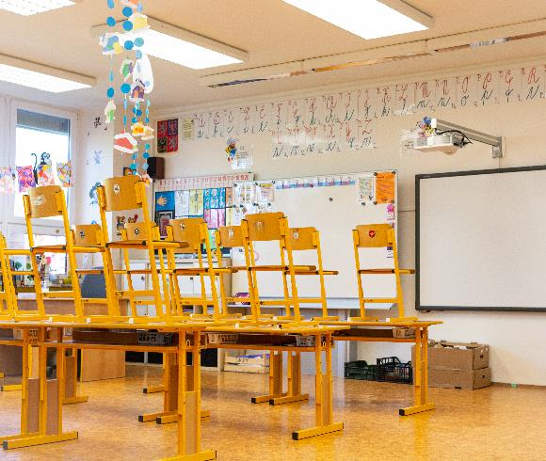
Lower primary school

Slide 11
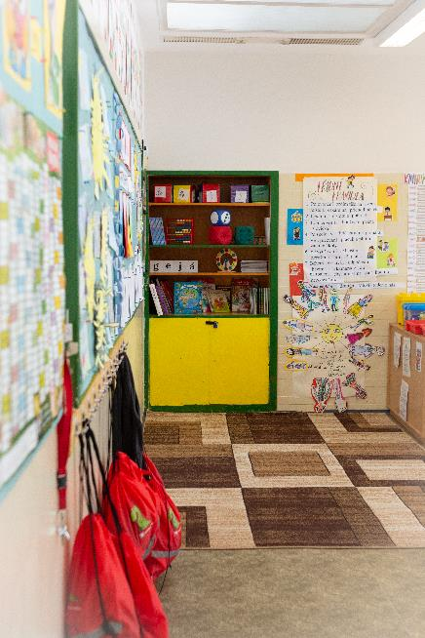
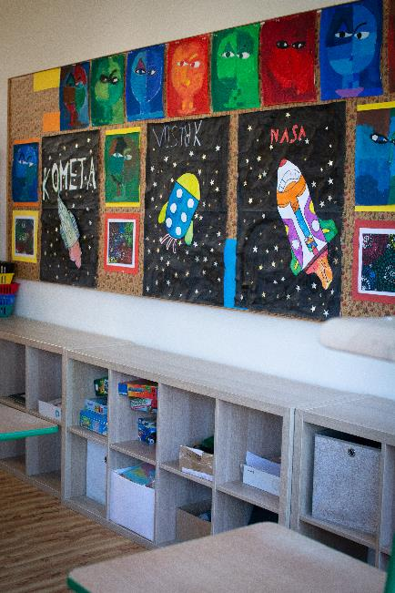
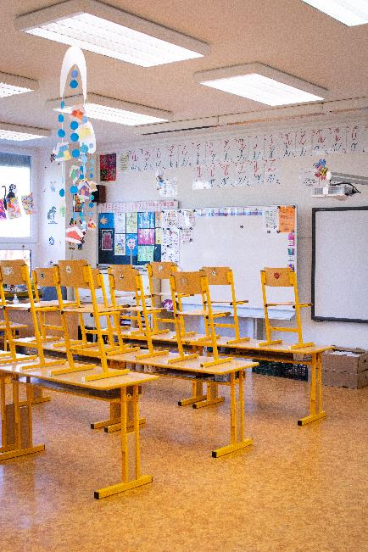
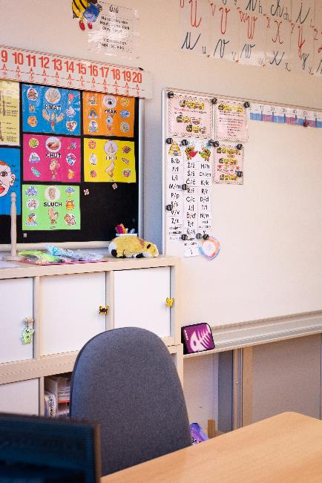
Lower primary school

Slide 12
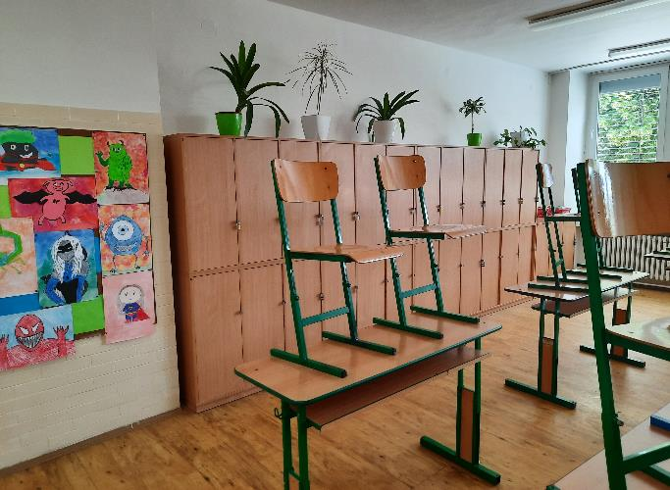
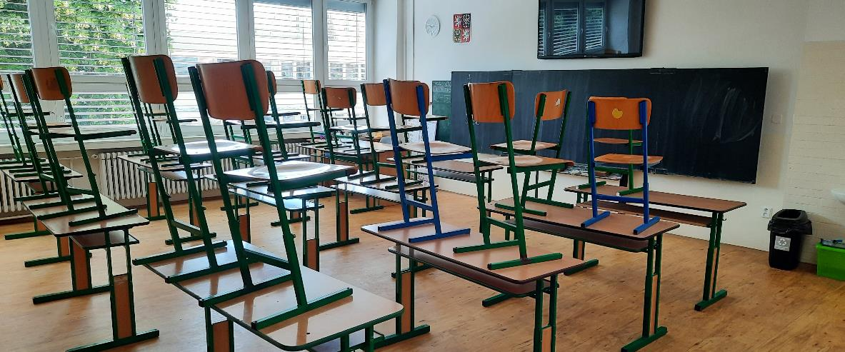
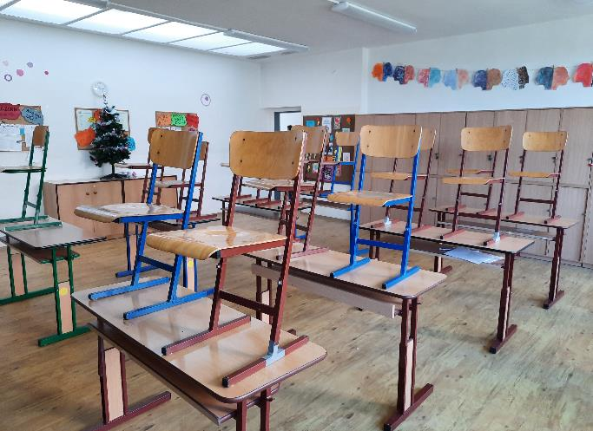
Upper primary school

Slide 13
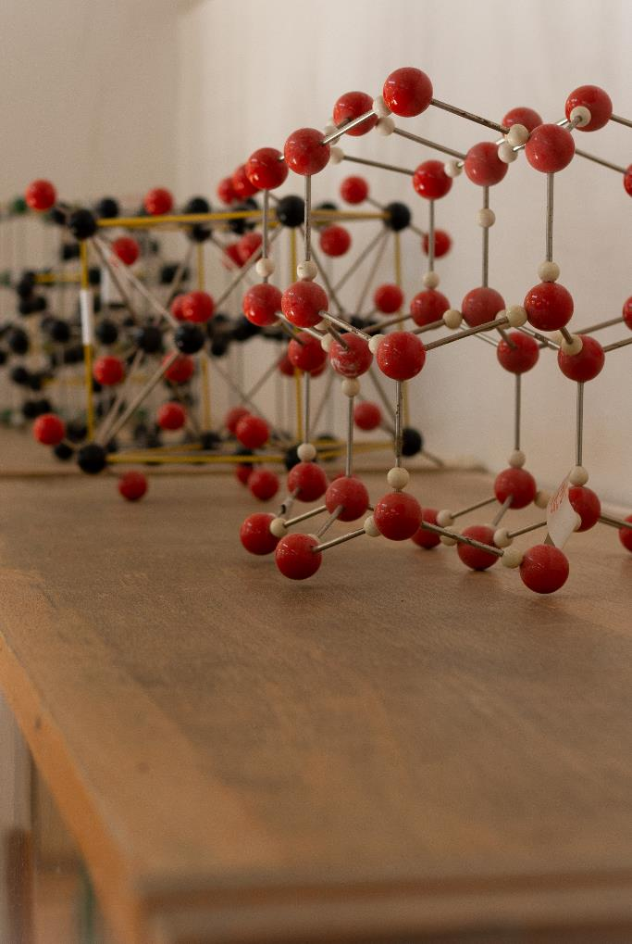
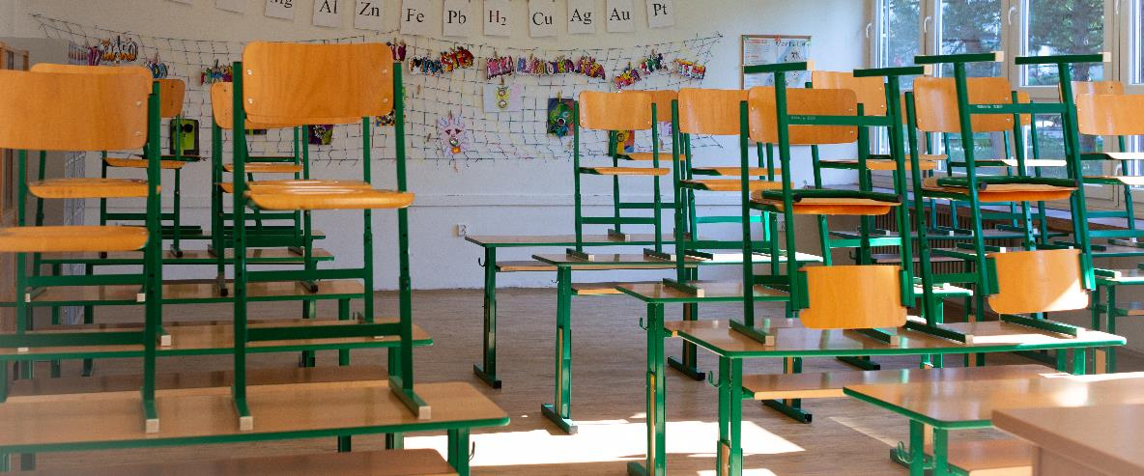
A classroom of Physics

Slide 14
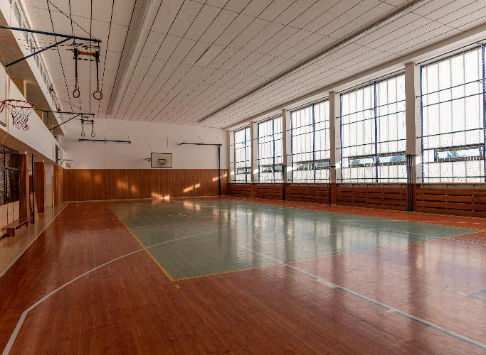
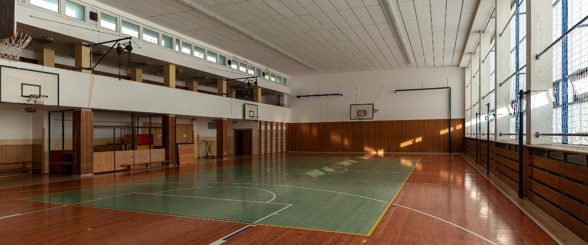
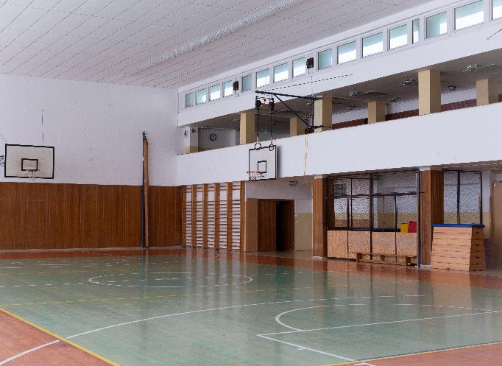
A gym

Slide 15
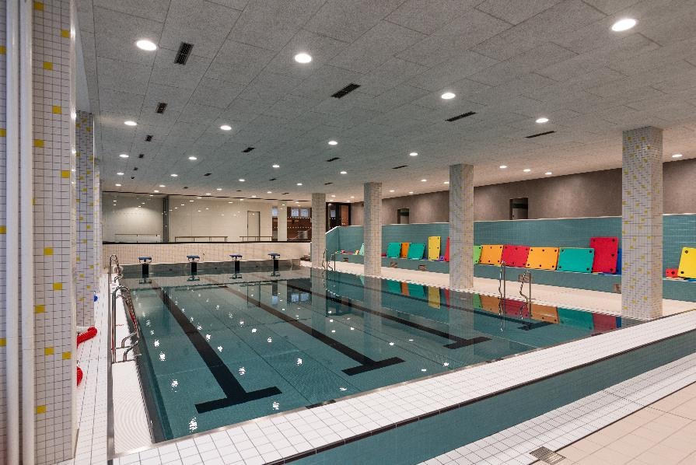
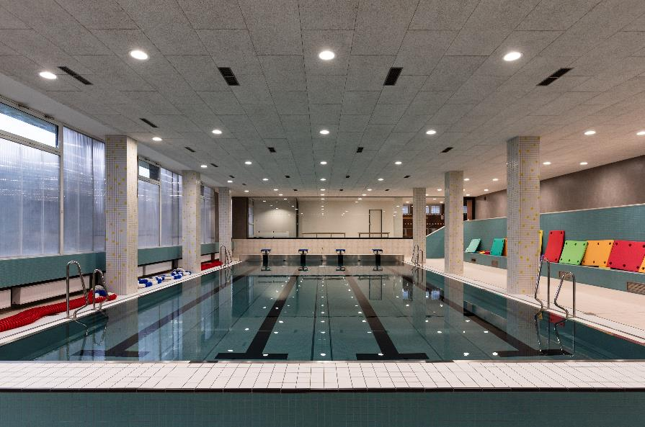
A swimming pool

Slide 16
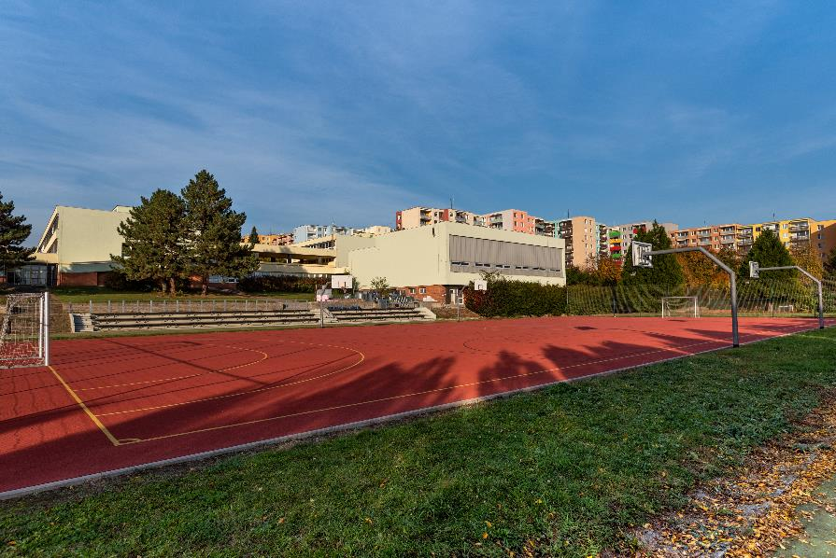
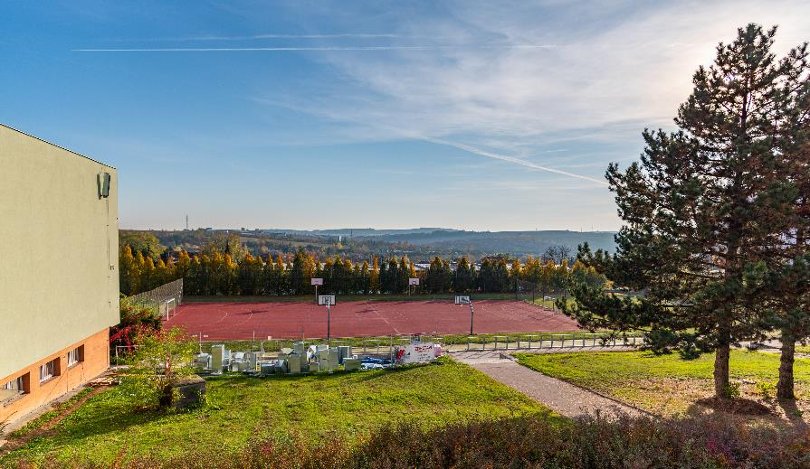
A playground

Slide 17
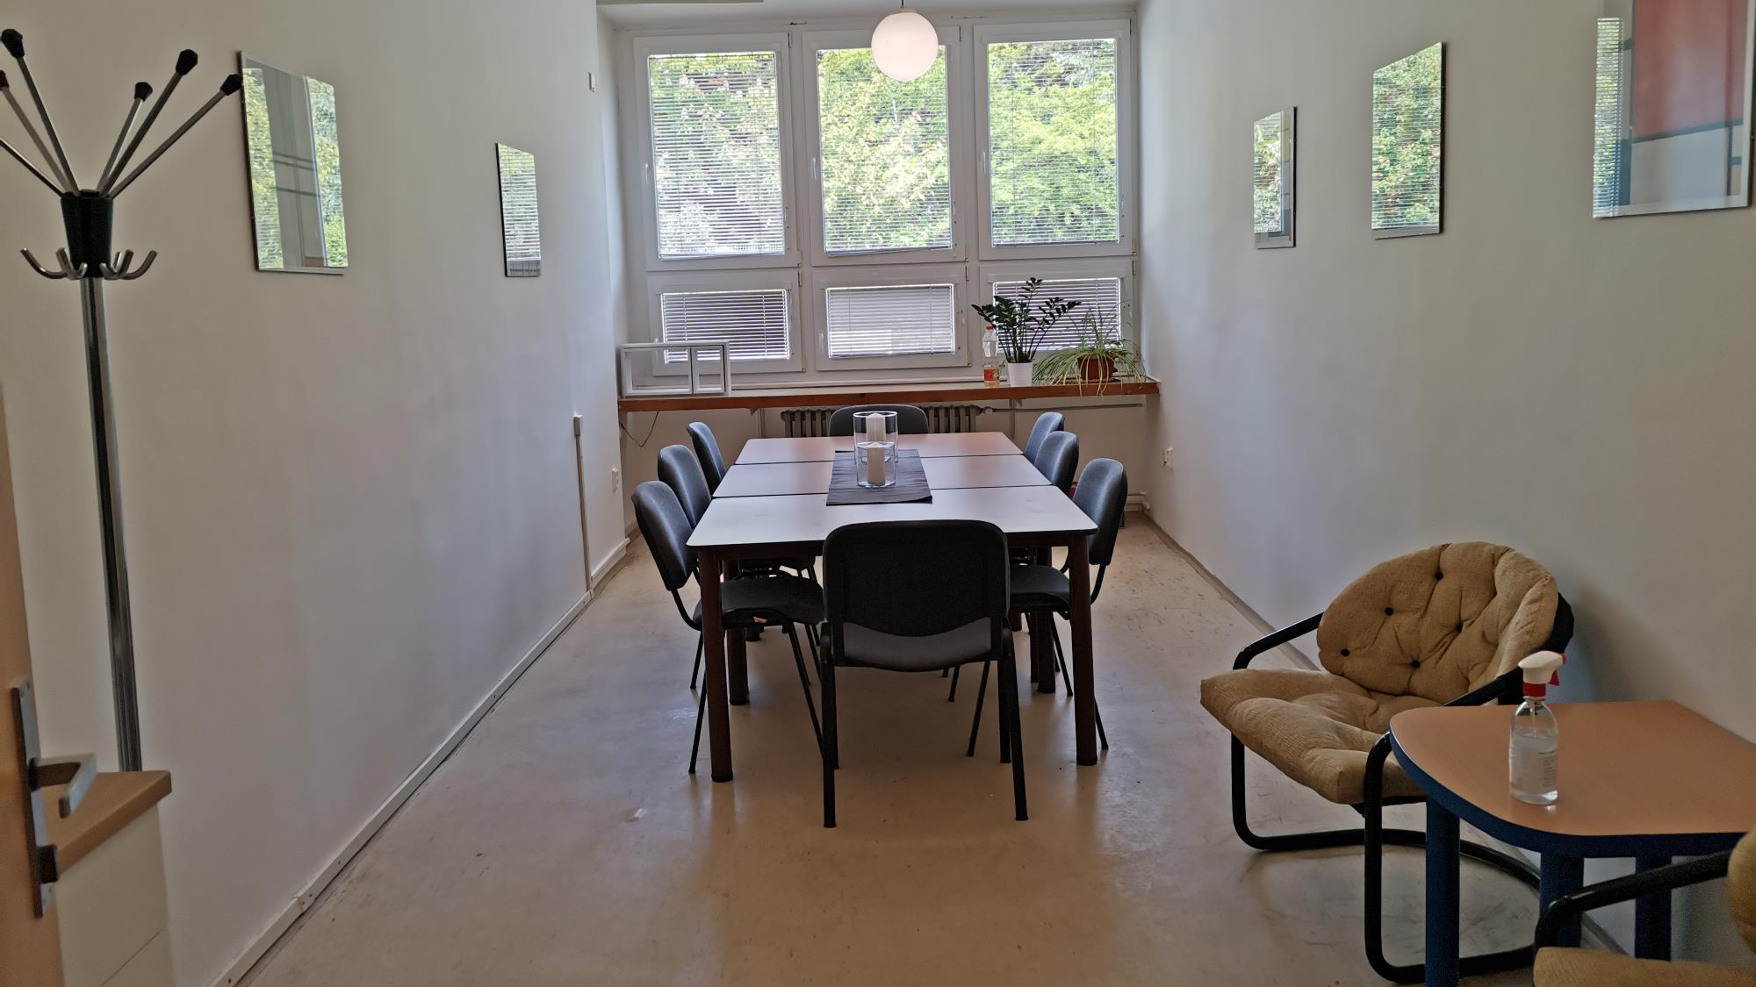
Meeting room

Slide 18
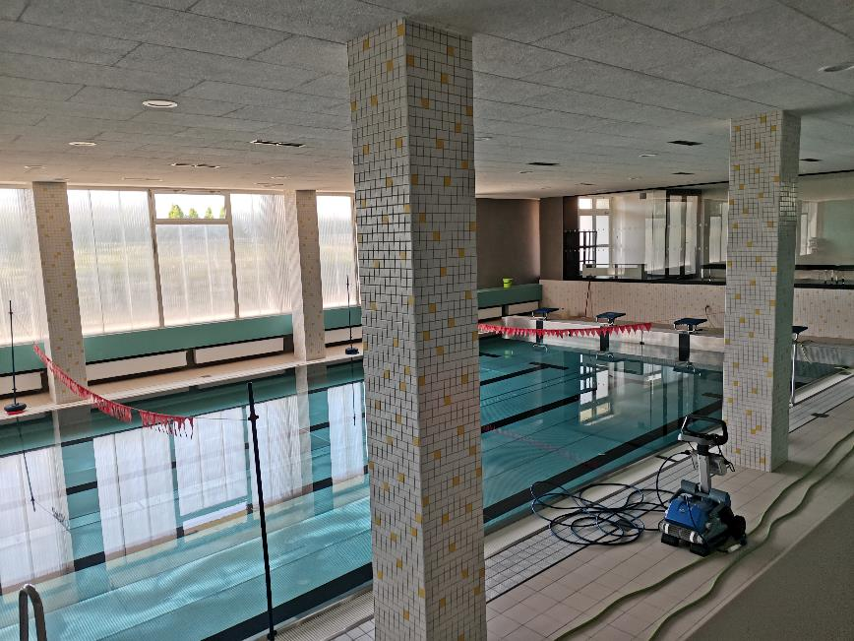
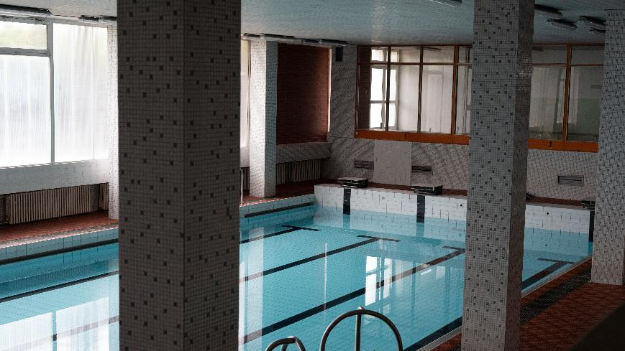
Swimming pool
2021
2018

Slide 19
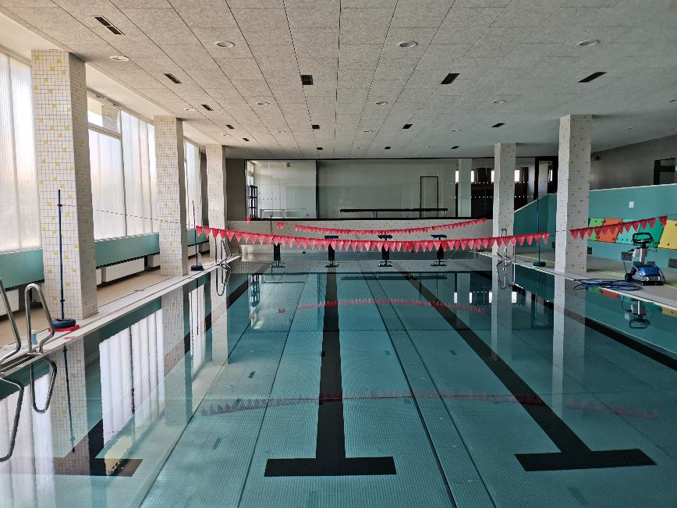
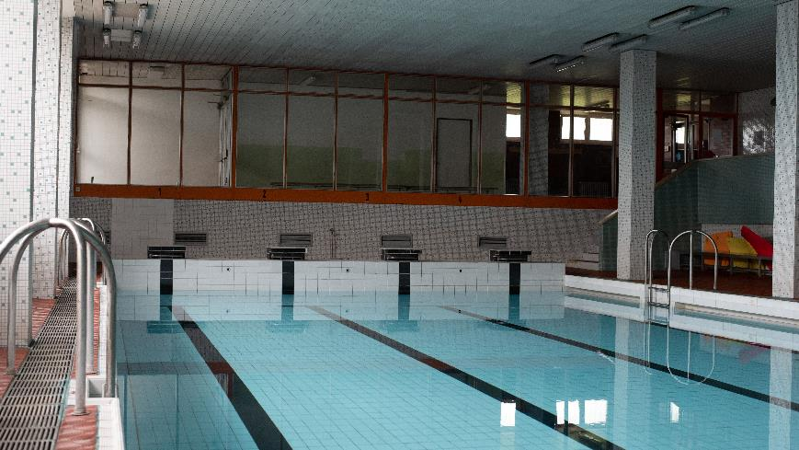
Swimming pool
2021
2018

Slide 20
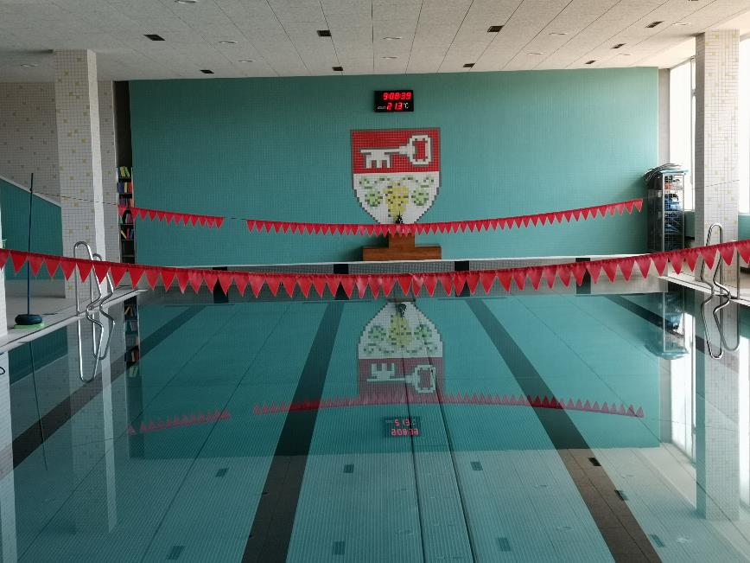
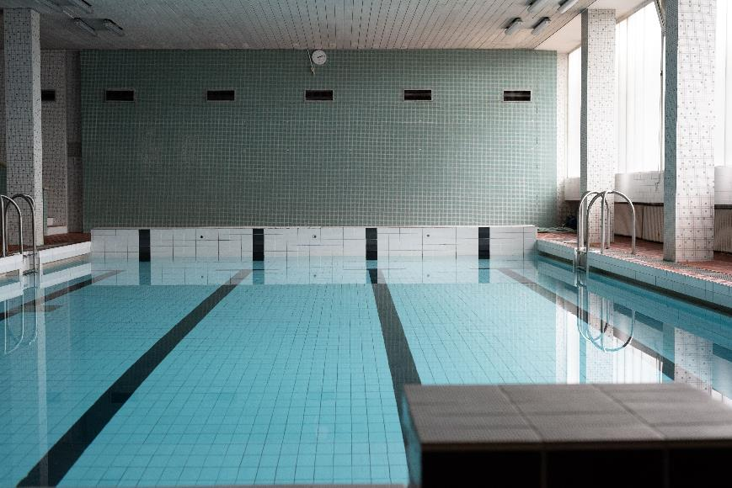
Swimming pool
2021
2018

Slide 21
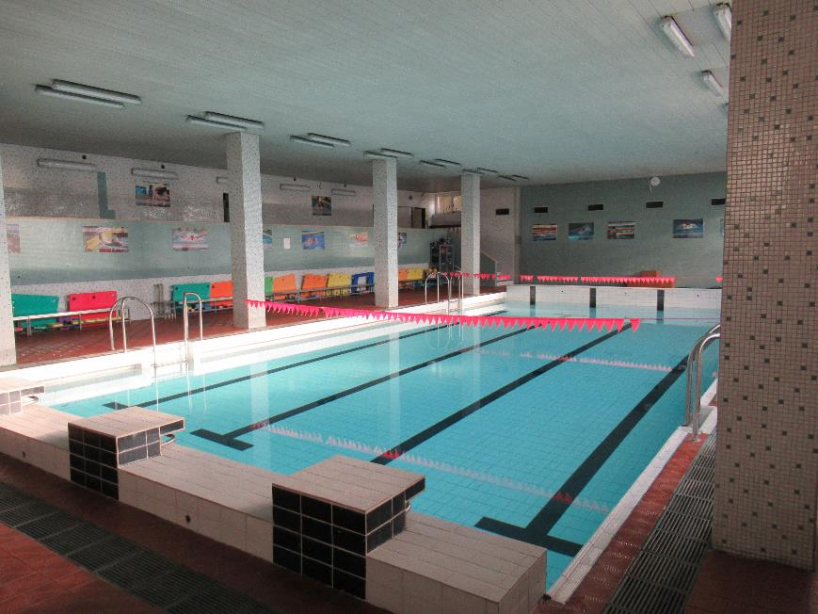
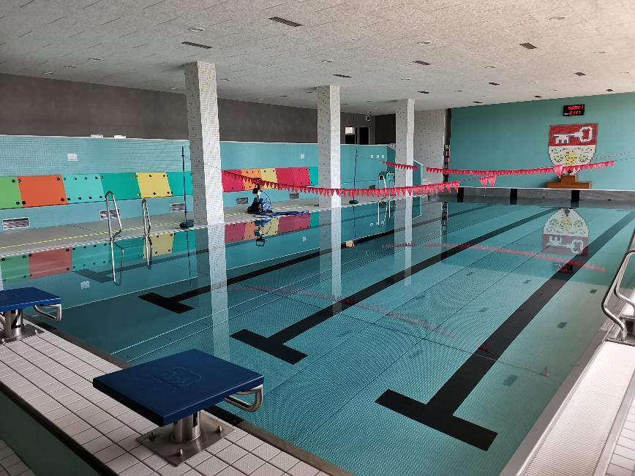
Swimming pool
2018
2021

Slide 22
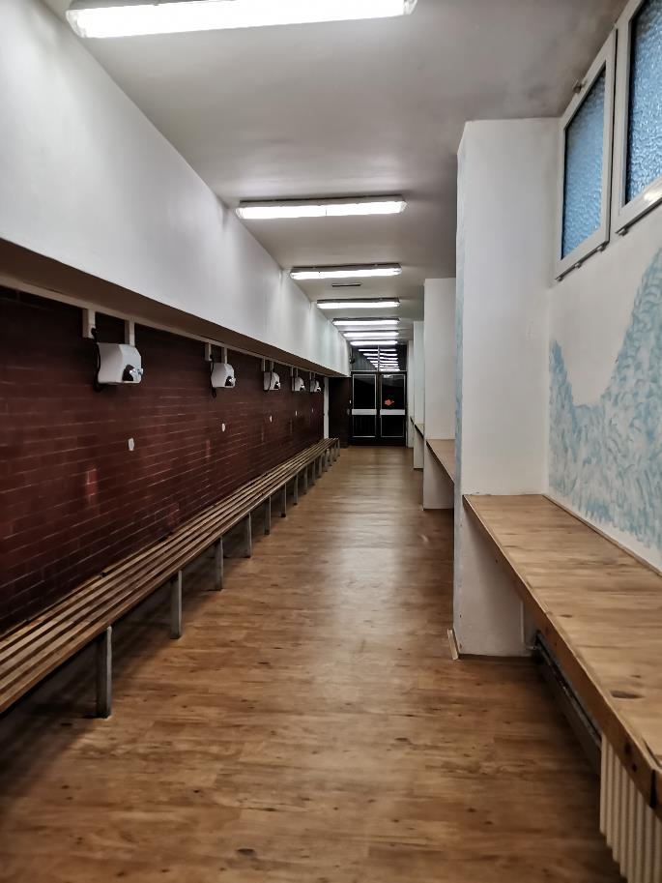
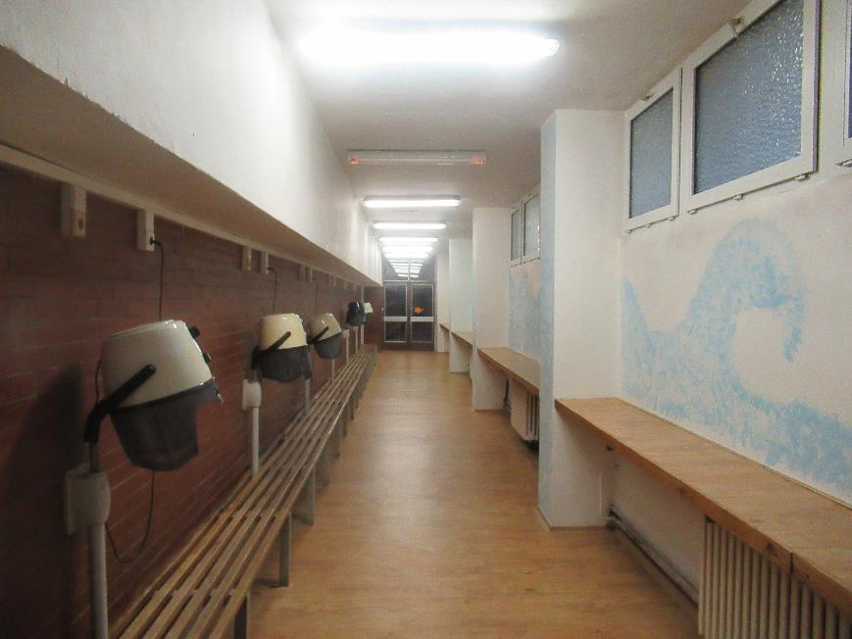
2021
2018

Slide 23
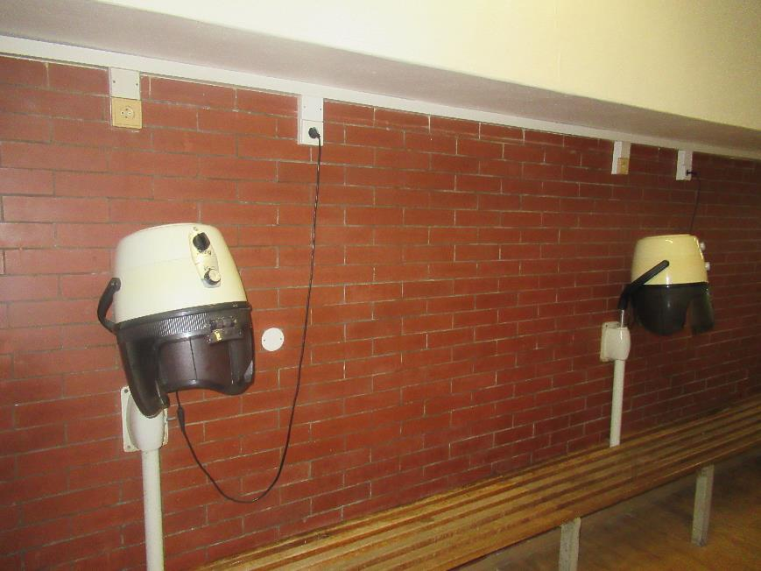
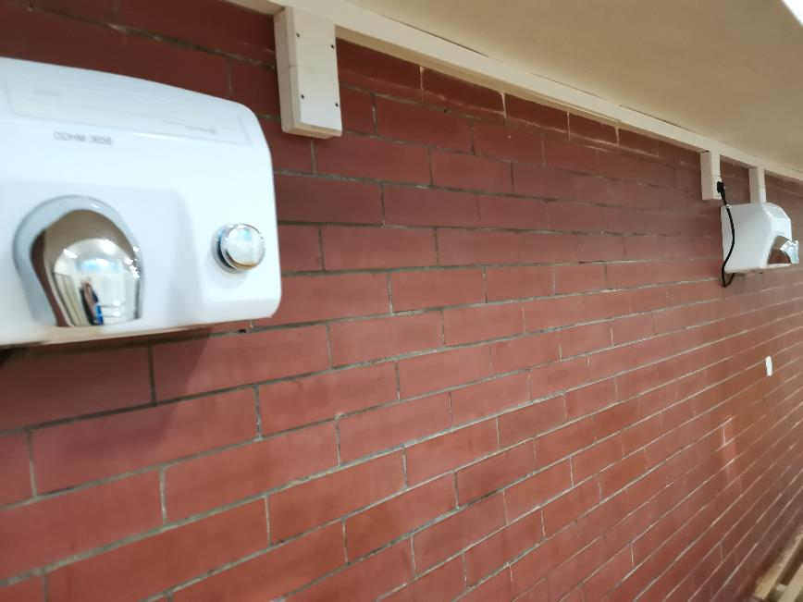
2018
2021

Slide 24
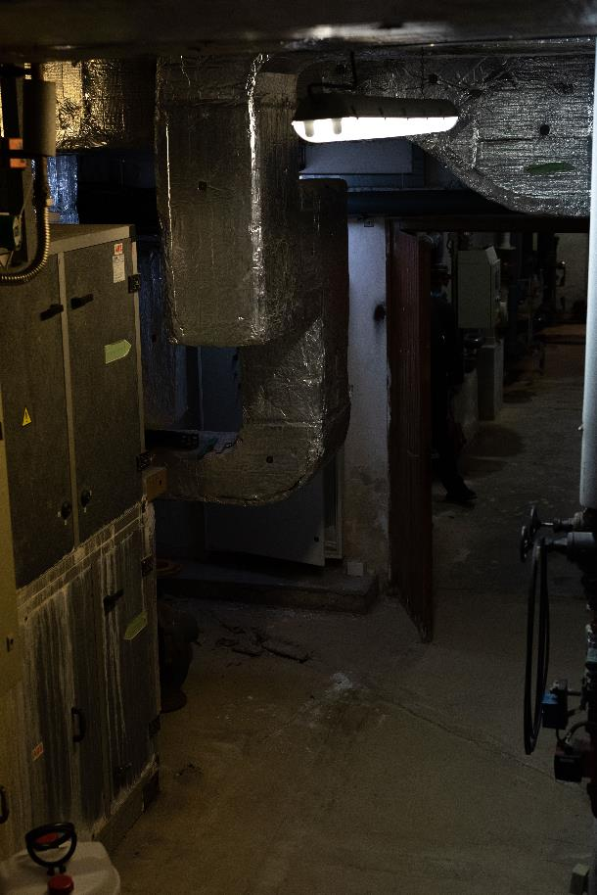
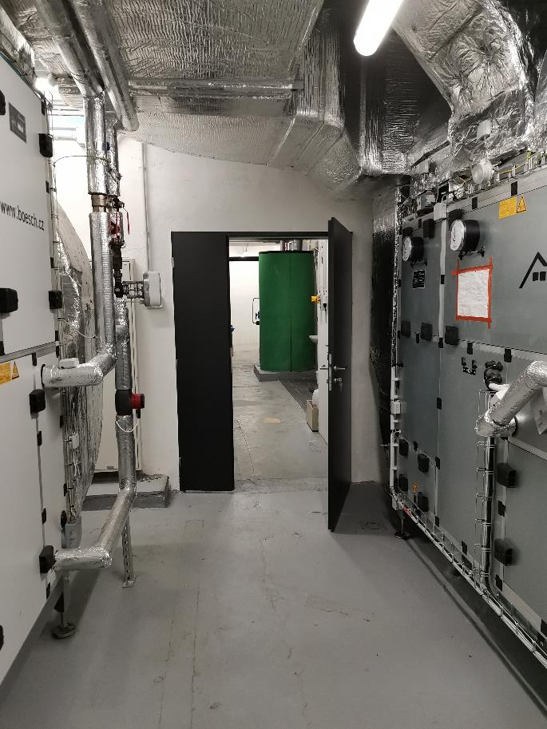
2018
2021

Slide 25
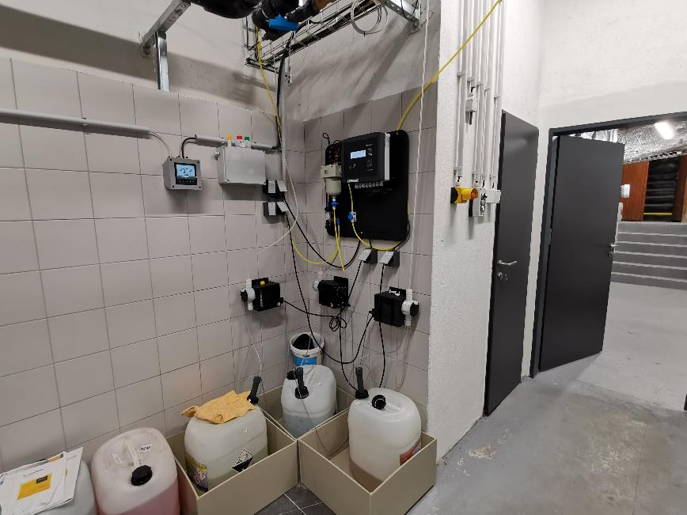
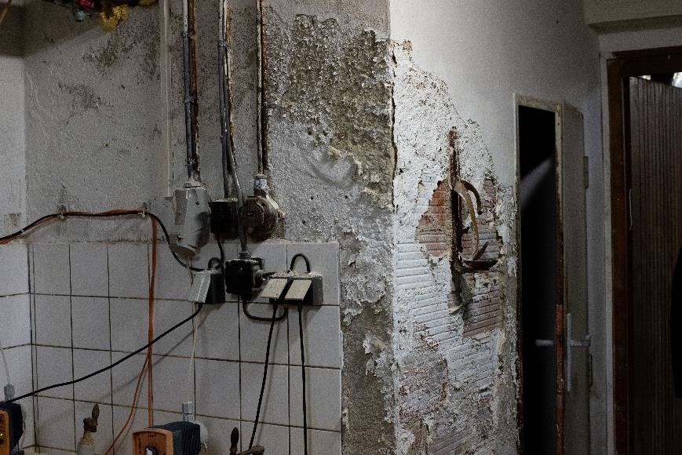
2021
2018

Slide 26
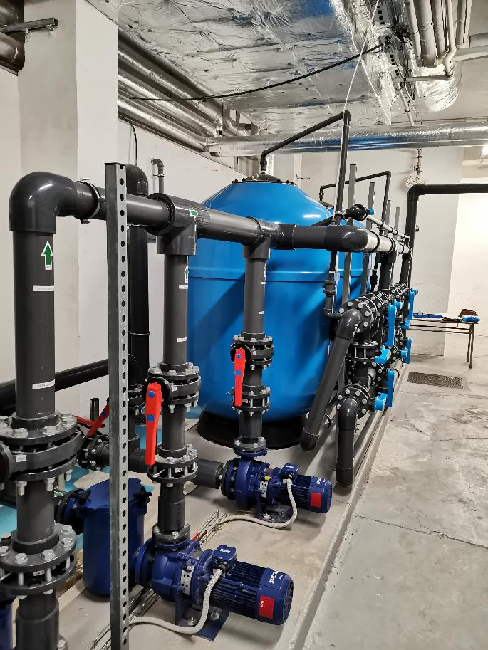
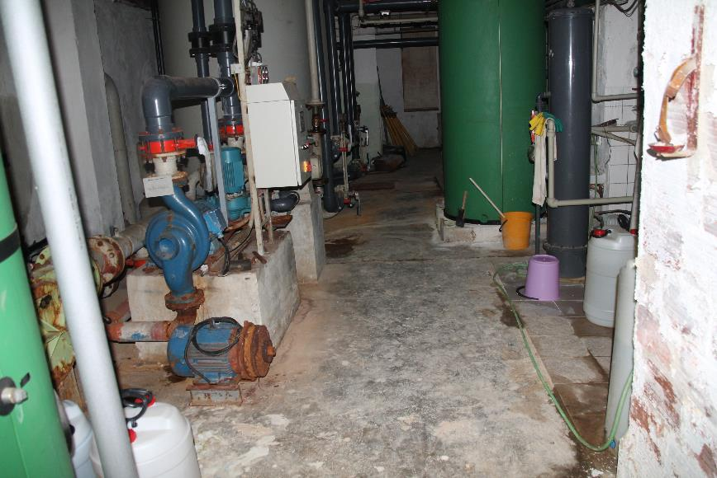
2021
2018

Slide 27
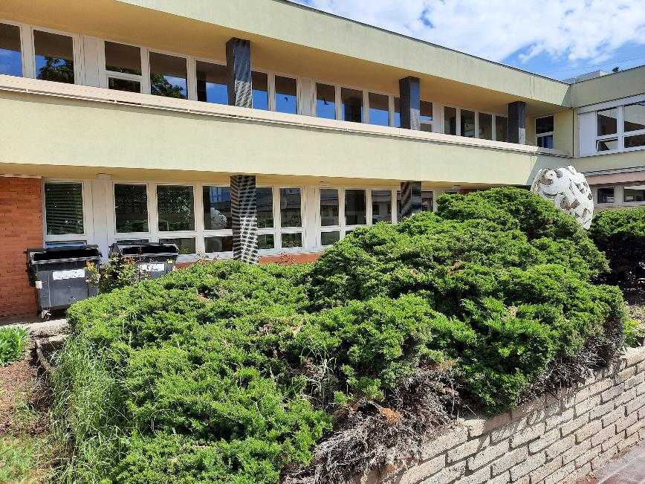
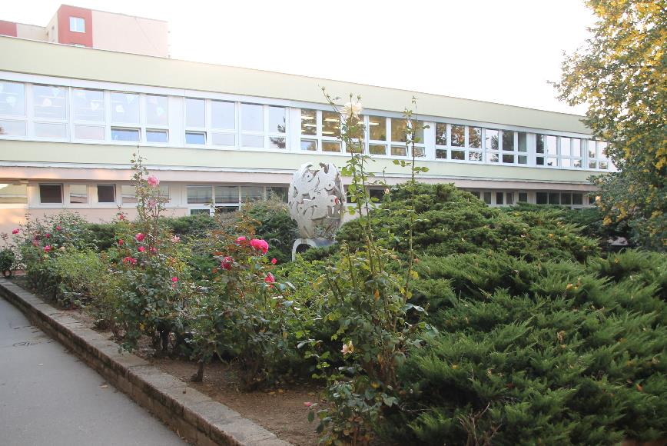
Atrium
2021
2018

Slide 28
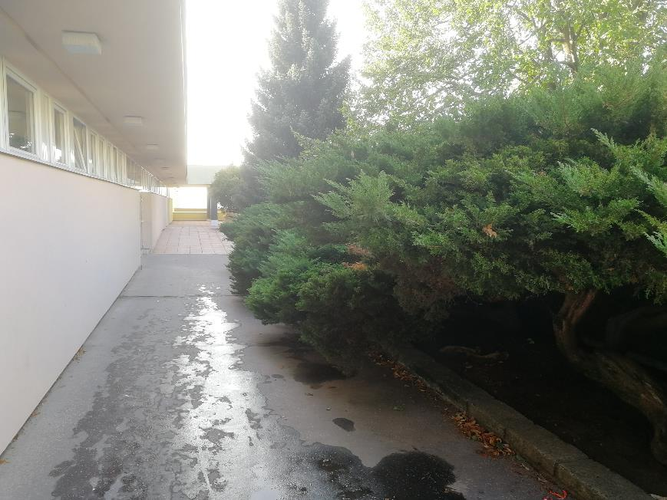
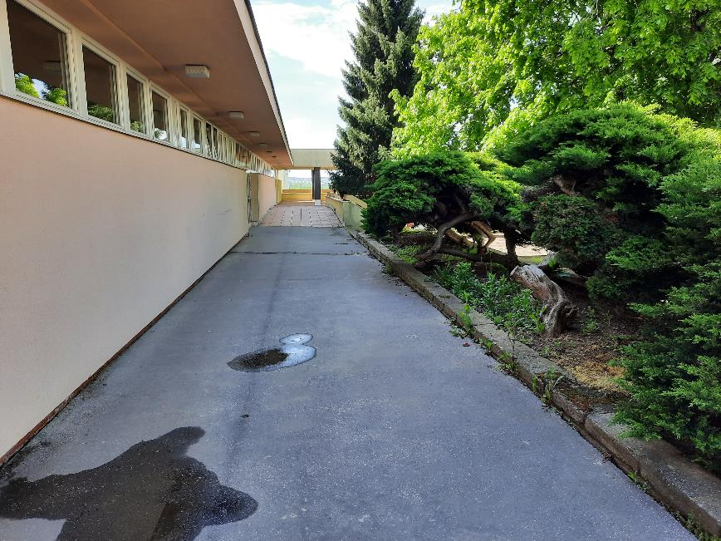
Atrium
2018
2021

Slide 29
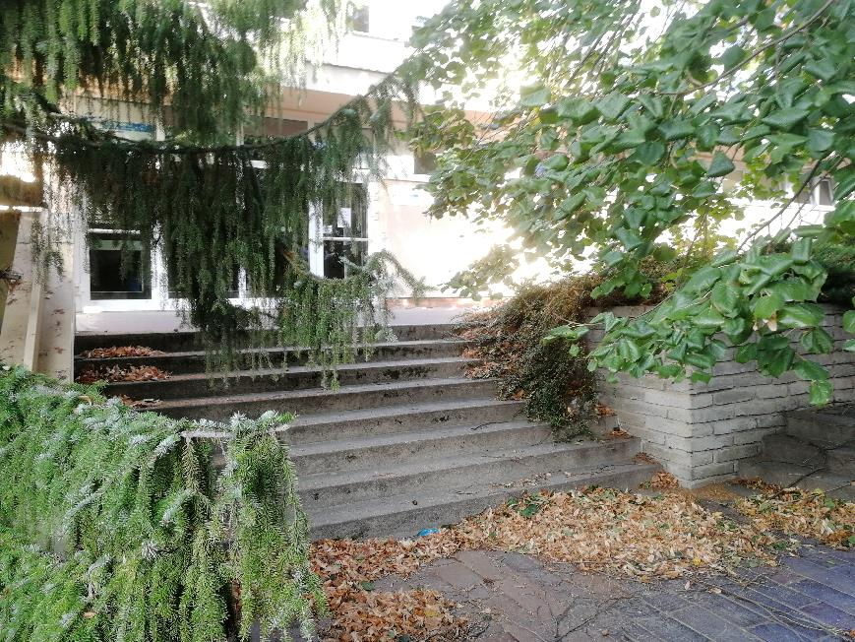
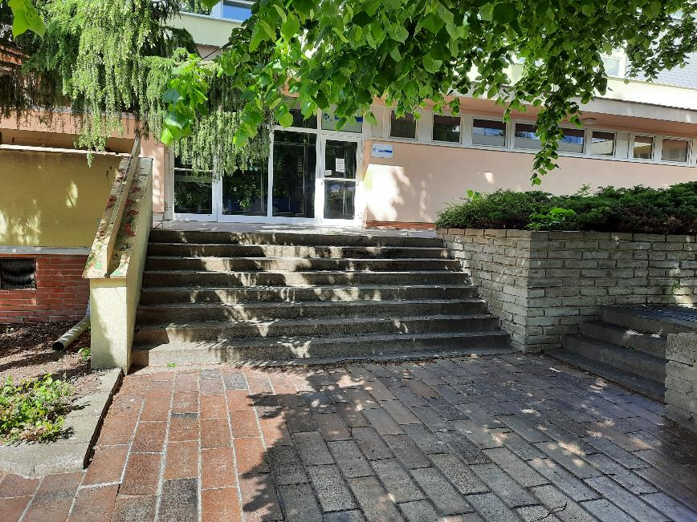
Atrium
2018
2021

Slide 30
Atrium
2021
2018

Slide 31
2018
2021

Slide 32
2018
2021

Slide 33
AN EATING GARDEN

Slide 35
2018
2021

Slide 36
2021
2018

Slide 37
2021
2018

Slide 38
2018
2021

Slide 39
2018
2021

Slide 40
Teacher‘s room
2018
2021

Slide 41
2021
2018

Slide 42
Paintings halls and respiriums

Slide 45
Our School Club
2018
2021

Slide 46
Our School Club
2018
2021

Slide 47
A School Club library

Slide 48
2021
2018

Slide 49
2018
2021

Slide 50
ICT classroom
2018
2021

Slide 51
ICT classroom
2018
2021

Slide 52
After-school club
2018
2021

Slide 53
After-school club
2018
2021

Slide 54
After-school club
2018
2021

Slide 55
2021
2018

Slide 56
2018
2021

Slide 57
2021
2018

Slide 58
2018
2021

Slide 59
2021
2018

Slide 60
2018
2021

Slide 61
A TEACHER‘S LOUNGE –
A COFFEE MAKER

Slide 62
2021
2018

Slide 63
2021
2018

Slide 64
2021
2018

Slide 65
2021
2018

Slide 66
2018
2021

Slide 67
2018
2021

Slide 68
2018
2021

Slide 69
2018
2021

Slide 70
2018
2021

Slide 71
Roof cleaning

Slide 72
2018
2021

Slide 73
2018
2021

Slide 74
2018
2021

Slide 75
A PREVIOUS KITCHEN

Slide 76
A PREVIOUS KITCHEN

Slide 77
A PREVIOUS KITCHEN
Our cooks stay, places are changing

Slide 78
UNDERGOING RECONSTRUCTION OF A SCHOOL KITCHEN

Slide 79
A new school kitchen

Slide 83
There are going to be more new renewed rooms and places.
Thank you for your support.
Elementary School Brno, Arménská 21

Slide 84
www.zsarmenska.cz

